Slide 1
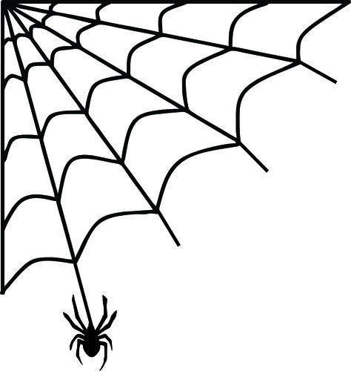

BUSQOM 1080 Supervised Learning I
Fall 2020
Lecture 21
Professor: Michael Hamilton

Slide 2
Lecture Summary
Today: An introduction to supervised learning
Machine Learning Overview [5 Mins]
Introduction to Supervised Learning [5 Mins]
K nearest neighbors algorithm [10 Mins]
Cross Validation [10 Mins]

Slide 3
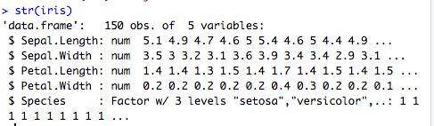
Data for lecture
Let’s use the native iris dataset in R. This is the first dataset we used
data = iris, 150 observations of different Iris flowers

Slide 4
Machine Learning vs Statistics
Machine Learning (ML) is the “the study of computer algorithms that improve automatically through experience”.
Theme of this class: How do we learn from data?
So far the methods we’ve since in this class have depended on a strong statistical motivation to answer this question.
First, we made assumptions about the underlying data generating processes, then we used that to run and evaluate them (hypothesis testing, linear regression, etc).
In ML we will be studying algorithms to find patterns in data directly, without first making assumptions about the underlying data generating distribution.
We will use the data itself to validate our methods, and to try and identify directly when and why they fail.

Slide 5
Machine Learning
Machine Learning is the “the study of computer algorithms that improve automatically through experience”.
ML is a huge space and it’s growing every year. It would be impossible to cover everything that’s happening in this massive field, in this class we will look at the basics of two branches of ML.
Supervised Learning (Classification) – The task here is learning how to label or classify new observations, given a dataset of labelled observations.
Unsupervised Learning (Clustering) – The task of automatically learning labels or classifications, given a dataset of unlabeled observations.

Slide 6
Introduction to Supervised Learning
Problem: Given a training set of labelled observations, we want to be able to predict the labels of new observations in the test set
Terminology:
The label of an observation is called the observations class.
The non-label information about each observation are it’s associated features.
The method we use to determine the label for points in the test set is called a classifier (it classifies the observations).

Slide 7
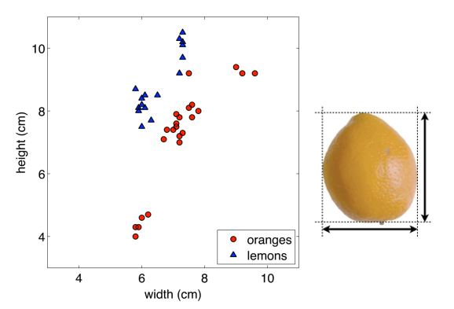
Classification Visualized: Sorting Fruit
Here’s a test point (unlabeled)
These are the training points (all labeled)
t
Question: Do you think the test point is an orange or lemon? Why?

Slide 8
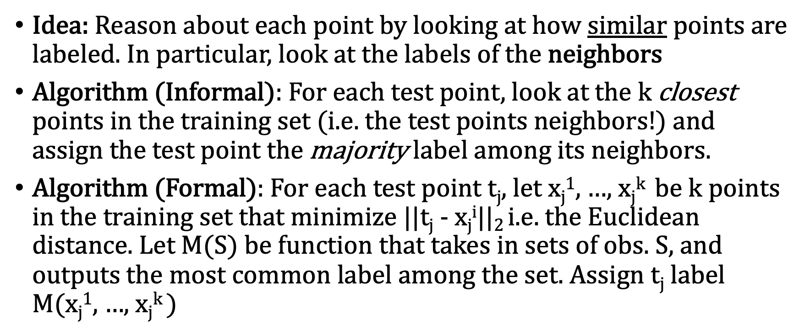
Topic: K Nearest Neighbors
Idea: Reason about each point by looking at how similar points are labeled. In particular, look at the labels of the neighbors
Algorithm (Informal): For each test point, look at the k closest points in the training set (i.e. the test points neighbors!) and assign the test point the majority label among its neighbors.
Algorithm (Formal): For each test point t_{j}, let x_{j}¹, …, x_{j}^{k} be k points in the training set that minimize ||t_{j} - x_{j}^{i}$||$₂ i.e. the Euclidean distance. Let M(S) be function that takes in sets of obs. S, and outputs the most common label among the set. Assign t_{j} label M(x_{j}¹, …, x_{j}^{k} )

Slide 9
4 Nearest Neighbors: Sorting Fruit
t’s four nearest neighbors are:
Majority label is Blue
t

Slide 10

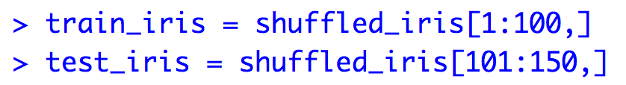
K Nearest Neighbors in R
First break iris into a training set and a testing set, randomly
Now:
> install.packages("class")
> library(class)
Sample(10) returns a random order of 1,2,3,4,5…

Slide 11
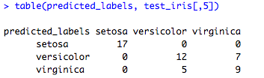
K Nearest Neighbors in R
> predicted_labels = knn(train_iris[,1:2], test_iris[,1:2], train_iris[,5], k = 10)
Training Data: Only two features corresponding to first two columns
Testing Data: Only two features corresponding to first two columns
Vector of labels for the training data
Number of neighbors to consider, k = 10
How good was the prediction?
Confusion Matrix
5 + 7 Predicted wrong
Accuracy = (50-12)/50

Slide 12
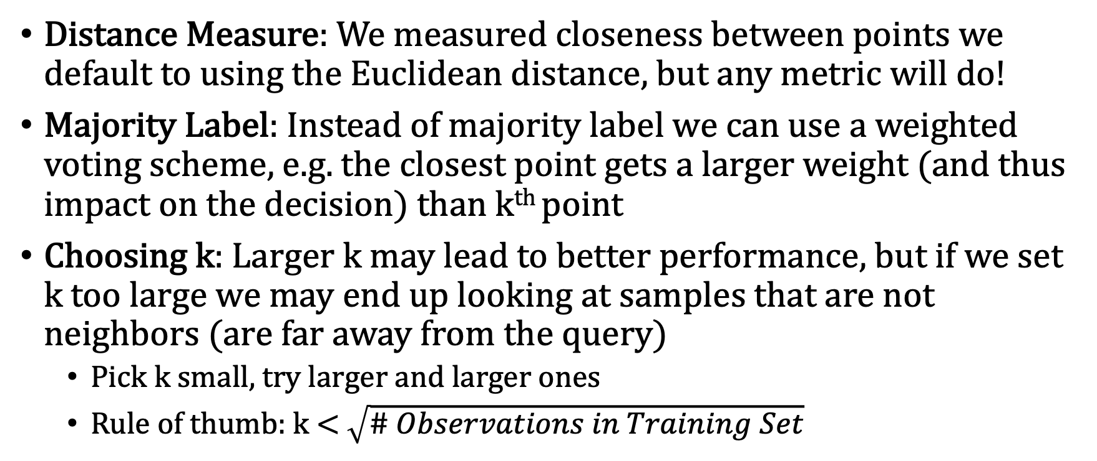
K Nearest Neighbors: Finer Points
Distance Measure: We measured closeness between points we default to using the Euclidean distance, but any metric will do!
Majority Label: Instead of majority label we can use a weighted voting scheme, e.g. the closest point gets a larger weight (and thus impact on the decision) than k^{th} point
Choosing k: Larger k may lead to better performance, but if we set k too large we may end up looking at samples that are not neighbors (are far away from the query)
Pick k small, try larger and larger ones
Rule of thumb: k < $\sqrt{\# Observations in Training Set}$

Slide 13
K Fold Cross Validation
Question: How do we decide what is a good (i.e. generalizable) choice of k? Can we answer such a question from the data itself?
Idea: Separate the data into a training set and testing set, randomly, many times. And see what k works best over the random splitting. This way k is fairly chosen, since it doesn’t depend on artifacts of the data which will be removed in the shuffling.
Cross Validation is a technique which involves reserving a particular sample of a data. Importantly, each observation in the data sample is assigned to an individual group and stays in that group for the duration of the procedure. This means that each sample is given the opportunity to be used in the hold out set 1 time and used to train the model k-1 times.
Steps:
Shuffle the dataset randomly.
Split the dataset into k groups
For each unique group:
Take the group as a hold out or test data set
Take the remaining groups as a training data set
Fit a model on the training set and evaluate it on the test set
Retain the evaluation score and discard the model
Summarize the skill of the model using the sample of model evaluation scores
K is usually 10

Slide 14
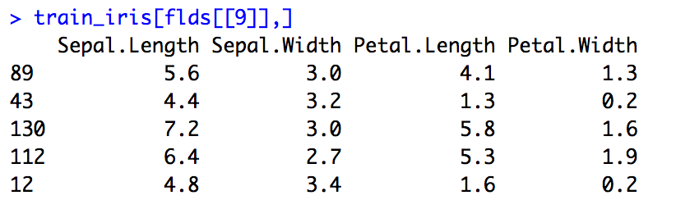
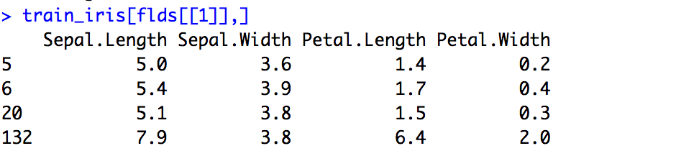
K Fold Cross Validation
Install package “caret” and run library(caret)
Now run kNN ten times, for each training and testset

Slide 15
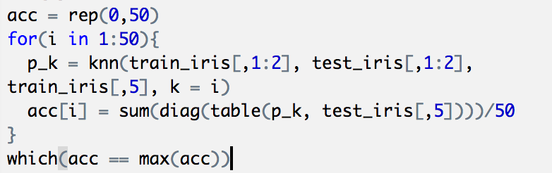
In Class Activity (Omitted, See Zoom)
Plot the test set with it’s true labels (i.e. different color for each species) and plot the test set with it’s assigned labels
Find the best k, i.e. the k that maximizes the prediction accuracy!
diag() gets elements on diagonal of table
which(bool_vec) returns the index of the TRUE
Colors points by class label inside []

